Slide 1
IMSE 802 Supply Chain Operations and Decision Making
Lecture 4
Chapter 3
Making and Delivering

Slide 2
Making and Delivering
Making and Delivering
Economic Lot Size Model
Monte Carlo Simulation
Simulation Example – Quantitative Risk Analysis

Slide 3
Making and Delivering
Product Design (Make)
The design of a product can significantly affect the supply chain.
Supply chain costs can become 50 percent of more of the product’s costs

Slide 4
Making and Delivering
Product Design (Make)
When considering product design from a supply chain perspective, the aim is to design products with fewer parts, simple designs, and modular construction from generic subassemblies.
Parts design strategies can impact the number of suppliers, inventory, assembly and speed to market
Support requirements are also molded into the supply chain

Slide 5
Making and Delivering
Product Design (Make)
Product design defines the shape of the supply chain
It impact the cost and availability of product
Design, procurement and manufacturing should work together in product design to avoid separate agendas and sub optimization
This will lead to success and profitability for the company

Slide 6
Making and Delivering
Product Design (Make)
Leverage cross-functional teams to:
Blend the best insights
Review and discuss relevant issues
Develop a strategy for suppliers
Simplify design
Address service levels
Discuss technical support
This will result in products that can be efficiently supported by the supply chain.

Slide 7
Making and Delivering
Production Scheduling (Make):
Allocates available capacity (equipment, labor and facilities) to the work that needs to be done
The goal is to use the available capacity in the most efficient and profitable manner
Balances between competing objectives:
High utilization rates
Low inventory levels
Hi levels of customer service

Slide 8
Making and Delivering
Production Scheduling (Make):
Decisions must be made around the time and quantity of items produced by a company
Most facilities are multi-product facilities and the decision can be more complex
We must determine an economical lot size for production which balances production setup costs with inventory carrying costs.

Slide 9
Making and Delivering
Production Scheduling (Make):
Economic Lot Size (ELS) is dead according to some advocates of Lean Manufacturing and Theory of Constraints. They contend that every operation should manufacture what the downstream customer needs immediately in "batches" of one unit. (One Piece Flow)
http://www.strategosinc.com/economic_lot_sizing.htm

Slide 10
Making and Delivering
Production Scheduling (Make):
This may be correct in an ideal world. Most factories are less than ideal. Where significant setup costs exist, batch quantity is still an issue and Economic Lot Size provides important insights for rational decisions.
http://www.strategosinc.com/economic_lot_sizing.htm

Slide 11
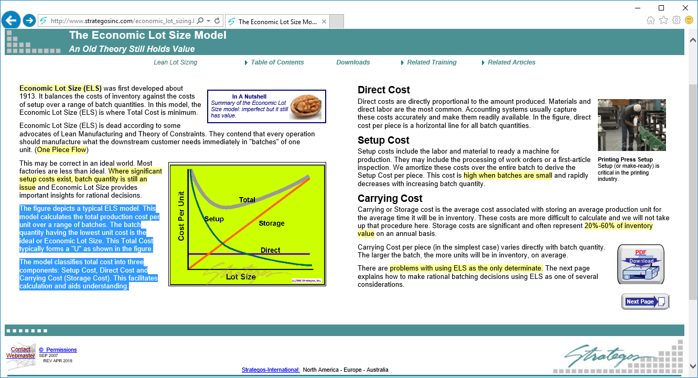
Making and Delivering
Production Scheduling (Make):
The ELS model calculates the total production cost per unit over a range of batches.
The batch quantity having the lowest unit cost is the ideal or Economic Lot Size.
This Total Cost typically forms a "U".
The model classifies total cost into three components: Setup Cost, Direct Cost and Carrying Cost (Storage Cost).
http://www.strategosinc.com/economic_lot_sizing.htm

Slide 12
Making and Delivering
Production Scheduling (Make):
Direct Cost
Direct costs are directly proportional to the amount produced (materials, labor)
Accounting systems capture these costs.
Direct cost is a horizontal line for all batch quantities.
http://www.strategosinc.com/economic_lot_sizing.htm

Slide 13
Making and Delivering
Production Scheduling (Make):
Setup Cost
Setup costs include the labor and material to ready a machine for production including work orders and inspection.
These costs are amortized over the entire batch to derive the Setup Cost per piece.
High when batches are small and decrease with larger batch sizes
http://www.strategosinc.com/economic_lot_sizing.htm

Slide 14
Making and Delivering
Production Scheduling (Make):
Carrying Cost
Carrying or Storage cost is the average cost associated with storing an average production unit for the average time it will be in inventory.
Can be difficult to calculate.
Can be represented as 20%-60% of inventory value on an annual basis.
Carrying Cost per piece varies directly with batch quantity.
http://www.strategosinc.com/economic_lot_sizing.htm

Slide 15
Production Lot Size
Production Scheduling (Make):
Economic Lot Size Model - Production Lot Size
Q = Production Lot Size
C = Production Cost
C₀ = Set-up cost
C_{h} = Holding Cost
D = Annual demand
P = Annual production capacity
IMAX = Q - D(Q/P) = (1-D/P)Q
Average inventory = IMAX/2 = ((1-D/P)/2)Q
Number of Set-ups per year = D/Q

Slide 16
Production Lot Size
Total Annual Cost
Instantaneous set-up time/infinite time horizon
TC(Q) = C_{O}(D/Q) + C_{h}((1-D/P)/2)Q + CD
Set-up cost *
Number of set-ups
Holding Cost *
Average Inventory
Production Cost * Demand

Slide 17
Optimal Production Lot Size – Q*
TC(Q) = C_{O}(D/Q) + C_{h}((1-D/P)/2)Q + CD

Slide 18
Example – Optimal Production Lot Size
Production Capacity 1000 tubes/hr.
Daily Demand 1680 tubes
Production cost $0.50/tube (C = 0.50)
Set-up cost $150 per set-up (C_{O} = 150)
Holding Cost rate: 40% (C_{h} = .4(.50) = .20)
Since demand is 1680 per day and the production rate is 1000 per hour:
D = 1680(365) = 613,200
P = 1000(24)(365) = 8,760,000

Slide 19
Example – Optimal Production Lot Size

Slide 20
Example – Total Annual Cost
Total Annual Cost
TC(Q) = TV(Q) + CD
TV(Q) = CO(D/Q) + Ch((1-D/P)/2)Q
= (150)(613,200/31,449) + .2((1- (613,200/8,760,000))(31,449)/2)
= $5,850
TC(Q) = TV(Q) + CD
=$5,850 + .5(613,200) = $312,450

Slide 21
Other Quantities
Length of a Production run = Q*/P =
31,449/8,760,000 = .00359yrs. = .00359(365)
= 1.31 days
Length of a Production cycle = Q*/D =
31,449/613,200 = .0512866yrs. = .00512866(365) = 18.72 days
# of Production runs/yr. = D/Q* = 19.5
I_{MAX} = (1-(613,200/8,760,000))(31,449) = 29,248

Slide 22
Making and Delivering

Slide 23
Making and Delivering
Facility Management (Make)
All facility-management decisions happen within the constraints set by decisions about the facility location
Location is one of the five supply chain drivers.
Usually expensive to shut down or build a new facility

Slide 24
Making and Delivering
Facility Management (Make)
Decisions are made in three key areas:
The role each facility will play – The activities performed at the facility
How capacity is allocated in each facility – Dictated by the role the facility plays
The allocation of suppliers and markets to each facility – Influenced by the first two decisions which will drive the types of suppliers and markets supported.

Slide 25
Making and Delivering
Order Management (Deliver)
Order management is the process of passing order information from customer back through the supply chain from retailers to distributors to service providers and producers.
It also includes passing information about order delivery dates, substitutions, backorders, etc. forward to customers

Slide 26
Making and Delivering
Order Management (Deliver)
Traditionally, these processes have relied on paper and telephone transactions.
Companies are moving to and relying more on automated systems to accomplish these goals.

Slide 27
Making and Delivering
Order Management (Deliver)
Typical processes
Generate purchase order
Supplier fills it from stock or other suppliers
The purchase order is turned into pick tickets, packing lists and invoices
This process is repeated through the supply chain.

Slide 28
Making and Delivering
Order Management (Deliver)
Supply chains are becoming more complex
Multiple tiers of suppliers
Outsourced service providers
Distribution channel partners
This can result in significant lag and lead times through the supply chain
Modern order management focuses on faster and more accurate movement of order related data

Slide 29
Making and Delivering
Order Management (Deliver)
Order management processes must also
Handle exceptions
Spot problems
Relay information to other areas of the supply chain
Take corrective action
Alerts from order management processes can assist with customer relationship management

Slide 30
Making and Delivering
Order Management (Deliver)
Basic principles
Enter the order data once and only once
Automate the order handling
Make order status visible to customer service agents
Integrate order management systems with other related systems to maintain data integrity

Slide 31
Efficient Order Management

Slide 32
Order Management - Example
Given below is a list of run time sub systems within Ignify eCommerce.
Catalog & Content Sub Systems
Checkout Sub System
Order Entry & Management Sub System
Customer Profile Sub System
ERP Integration Sub System
Reporting Sub System

Slide 33
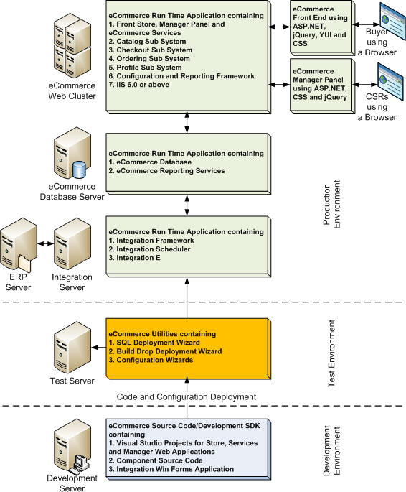
Order Management – Payment Process
http://www.ignify.com/Ignify-eCommerce-Technical-Architecture.asp

Slide 34
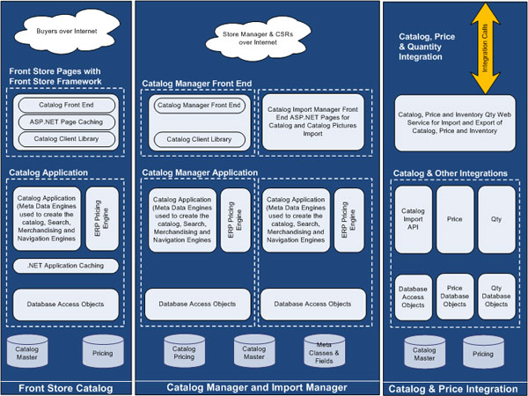
Order Management – Catalog Subsystem
http://www.ignify.com/Ignify-eCommerce-Technical-Architecture.asp

Slide 35
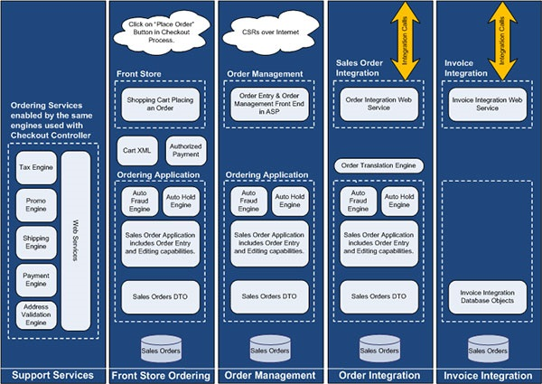
Order Management – Ordering
http://www.ignify.com/Ignify-eCommerce-Technical-Architecture.asp

Slide 36
Making and Delivering
Delivery Scheduling (Deliver)
Delivery scheduling works within the constraints set by the transportation decisions.
For most modes of transportation, there are two types of delivery methods:
Direct deliveries
Milk-run deliveries

Slide 37
Making and Delivering
Delivery Scheduling (Deliver)
Direct deliveries
Made from one originating location to one receiving location.
Routing is a matter of selecting the shortest path between the two locations
Simplicity in execution
Moves product from where it is made to where it is used
Efficient if the same as EOQ quantities and full truck load (TL)
Less efficient if less than truck load (LTL)

Slide 38
Making and Delivering
Delivery Scheduling (Deliver)
Milk-Run Deliveries
Trucks are routed from a single originating location to multiple receiving locations or deliveries that bring products from multiple originating locations to a single receiving location
Much more complex task
Decision must be made about delivery quantities, frequencies, routing and sequencing
This can be very cost efficient

Slide 39
Making and Delivering
Delivery Scheduling (Deliver)
Milk-Run Deliveries
Two primary techniques are used:
The savings matrix technique
The generalized assignment technique

Slide 40
Making and Delivering
Delivery Scheduling (Deliver)
Milk-Run Deliveries
The savings matrix technique
Assign customers to vehicles
Design routes meeting the delivery-time windows
Address other constraints
Reasonably good routing solution
Practical to use
Weakness: Often you are able to find more cost-effective solutions using the generalized assignment technique.
Best used with many different constraints

Slide 41
Making and Delivering
Delivery Scheduling (Deliver)
Milk-Run Deliveries
The generalized assignment technique
More sophisticated
Usually a better solution
Harder time to generate good delivery schedules with more and more constraints
Best used when the delivery constraints are limited to vehicle capacity or total travel time.

Slide 42
Making and Delivering
Delivery Sources:
Deliveries can be made to customers from two sources:
Single-product locations – Factories or warehouses where a single product or narrow range of items are shipped
Distribution centers (DCs) – Facilities where bulk shipments of products arrive from locations and the distribution center provides economics of scale to warehouse, combine or cross-dock orders to distribute product.

Slide 43
Making and Delivering
Return Processing (Deliver)
This is known as reverse logistics
All supply chains must deal with returns
Can be difficult and inefficient
End customers, retailers, distributors and manufacturers all return products.

Slide 44
Making and Delivering
Return Processing (Deliver)
Circumstances for returning product
Wrong product delivered
Products damaged in transit
Defective products
Wrong amount of product
Obsolescence allowances
And others……

Slide 45
Making and Delivering
Return Processing (Deliver)
Companies should
Track returns carefully
Have efficient processes
Have appropriate interfaces with customer credits, etc.
Provide return feedback to the appropriate functional organization
Systematically disposition the returned product, i.e., refurbish, dispose, re-box, recycle, etc.

Slide 46
Making and Delivering
Supply Chains for Disaster Response
High levels of unpredictability
Not established like commercial supply chains
Must operate in highly unpredictable environments
Ad-organization
Are assembled quickly
Must be coordinated without clear lines of authority

Slide 47
Making and Delivering
Supply Chains for Disaster Response
Research can aid in prepositioning supplies
Cloud-Based Platforms can be used for training and collaboration
Mission and Operations Planning (M&OP) can provide structure and sequencing of operations
Simulation can be used to quickly test response scenarios

Slide 48
Making and Delivering
Outsourcing Supply Chain Functions
Pressure on corporate profits and the reduction of expenses leads to questing what functions can be done better, cheaper, faster, etc. by other organizations.
The ongoing question and analysis will be…Should we do this function ourselves or can someone do this better than we can???

Slide 49
Making and Delivering
Outsourcing Supply Chain Functions
Pressure on corporate profits and the reduction of expenses leads to questing what functions can be done better, cheaper, faster, etc. by other organizations.
The ongoing question and analysis will be…Should we do this function ourselves or can someone do this better than we can???

Slide 50
Monte Carlo Simulation

Slide 51
Simulation
A computer-based model used to run experiments on a real system.
Typically done on a computer.
Determines reactions to different operating rules or change in structure.
Can be used in conjunction with traditional statistical and management science techniques

Slide 52
Difference Between Optimization and Simulation
Optimization models
Yield decision variables as outputs
Promise the best (optimal) solution to the model
Simulation models
Require the decision variables as inputs
Give a satisfactory answer

Slide 53
Types of Simulation Models
Continuous
Based on mathematical equations.
Used for simulating continuous values for all points in time.
Example: The amount of time a person spends in a queue.
Discrete
Used for simulating specific values or specific points.
Example: Number of people in a waiting line (queue).

Slide 54
Simulation Methodology
Estimate probabilities of future events
Assign random number ranges to percentages (probabilities)
Obtain random numbers
Use random numbers to “simulate” events.

Slide 55
Data Collection and Random Number Example
Suppose you timed 20 athletes running the 100-yard dash and tallied the information into the four time intervals below.
You then count the tallies and make a frequency distribution.
Then convert the frequencies into percentages.
Finally, use the percentages to develop the random number intervals.
Seconds
0-5.99
6-6.99
7-7.99
8 or more
Tallies
Frequency
4
10
4
2
%
20
50
20
10
RN Intervals
01-20
21-70
71-90
91-100

Slide 56
Event Probabilities and Random Numbers
Event Probabilities
From historical data
From expert opinion
Random Numbers
From probability distributions that ‘fit’ the historical data or can be assumed (use Excel functions)
From manual random number tables

Slide 57
Probability Distributions
A probability distribution defines the behavior of a variable by defining its limits, central tendency and nature
Mean
Standard Deviation
Upper and Lower Limits
Continuous or Discrete
Examples are:
Normal Distribution (continuous)
Binomial (discrete)
Poisson (discrete)
Uniform (continuous or discrete)
Custom (create your own!)

Slide 58
Normal Distributions
Conditions:
Uncertain variable is symmetric about the mean
Uncertain variable is more likely to be in vicinity of the mean than far away
Use when:
Distribution of x is normal (for any sample size)
Distribution of x is not normal, but the distribution of sample means (x-bar) will be normally distributed with samples of size 30 or more (Central Limit Theorem)
Excel function: NORMSDIST() – returns a random number from the cumulative standard normal distribution with a mean of zero and a standard deviation of one [e.g., NORMSDIST(1) = .84]

Slide 59
Uniform Distribution
All values between minimum and maximum occur with equal likelihood
Conditions
Minimum Value is Fixed
Maximum Value is Fixed
All values occur with equal likelihood
Excel function: RAND() – returns a uniformly distributed random number in the range (0,1)

Slide 60
Three Point Estimates
The Three Point Estimate technique is used to arrive at a better estimate of the time required to complete a particular activity.
This technique can be used for time and cost.
Two key approaches are used with the three point estimates
Triangular Distribution – Judgement Estimates
Beta Distribution (PERT Estimate) – More historical data is available

Slide 61
Triangular Distribution
This is like a simple average of the three estimates.
When plotted in a chart, it usually results in a sharp peak, thus the name Triangular Distribution.
This is like a simple average of the three estimates.
When plotted in a chart, it usually results in a sharp peak, thus the name Triangular Distribution.
Triangular Distribution:
Mean - (P + O + ML ) / 3
Variance = (P² + O² + ML² – P*O – P*ML – O*ML)/18
Where P = Pessimistic, O = Optimistic, ML = Most Likely

Slide 62
Beta Distribution
This is a weighted average.
More weight is given to the most likely.
The beta distribution will result in an more uniform, bell shaped curve, called a normal distribution.
Beta Distribution (PERT):
Mean = (P + O + 4ML ) / 6
Variance = ((P - O)/6)²

Slide 63
Excel – Random numbers
=RAND( )
Generates real values: 0 <= val < 1
=RANDBETWEEN (low, high)
Generates integers: low <= val <= high
To use in Excel
IF (RAND ( ) < 0.5, 0, 1)
IF (A2 <= 0.33, 0, (IF A2 <= 0.66, 1, 2)

Slide 64
Example: Random Service Times
Integer value 1 to 10, inclusive
=RANDBETWEEN (1, 10)
Integer value with given probability
3 @ 30%; 6 @ 45%, 10 @ 25%
Develop cumulative probability
0 - .3 -> 3
.3 - .75 -> 6
.75 – 1 -> 10
IF (A2 <= 0.3, 3, (IF A2 <= 0.75, 6, 10)

Slide 65
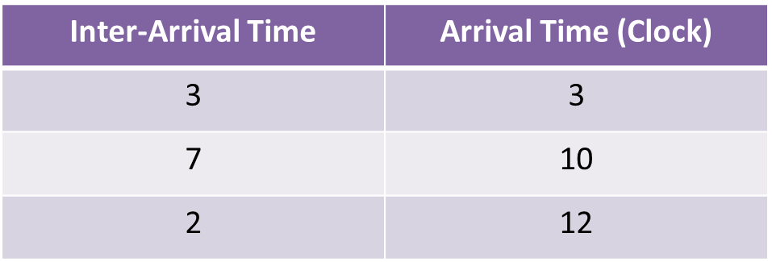
Example: Arrival Times
Arrival Time vs. Inter-Arrival Time
Arrival time – Clock time of arrival
Inter-Arrival Time: time between successive arrivals
Example: Initialize: Clock = 0

Slide 66
Random Number in Excel
Once entered in a spreadsheet, a random number function remains “live.”
A new random number is created whenever the spreadsheet is re-calculated.
To re-calculate the spreadsheet, use the F9 key.
If you do not want the random number to change, you can freeze it by selecting: tools, options, calculations, and checking “manual.”

Slide 67
Advantages of Simulation
Simulation is more general than mathematical models.
Simulation can be used when data is hard to come by.
Simulation can provide a more realistic replication of a system than mathematical analysis.
Simulation can be used to analyze transient conditions, whereas mathematical techniques usually cannot.
Simulation considers variation and can calculate confidence intervals of model results.
Simulation can also test a “range” of inputs to perform what-if/sensitivity analysis.

Slide 68
Disadvantages of Simulation
Simulation may be less accurate than mathematical analysis because it is randomly based.
Building a simulation model can take a great deal of time
The technique of simulation still lacks a standardized approach.
The simulation model is only as good as the model of the system being tested.

Slide 69
Simulation Example
Quantitative Risk Analysis

Slide 70
Quantitative Risk Analysis Terminology
Deterministic Finish Date
Finish date from the planning schedule.
Deterministic Cost
Estimated total project Cost
P-Value
Probability that the project will finish by a selected date and/or equal the projected cost.

Slide 71
Quantitative Risk Analysis Terminology
Duration/Cost Uncertainty
Range of values that describes the minimum and maximum amount of duration or cost for an individual activity including normal variability.
Discrete Risk Event
Individual risk events with a probability of happening and a consequence of additional time and/or money.
Mitigation
New work that reduces either the probability of a risk event happening or lessens its consequences.

Slide 72
Traditional Project Risk Analysis
Relies on the Risk Analysis Matrix and the Risk Register
Focuses on the “red” risks whether or not they have significant impact associated with all risk events.
Uses the point estimates for the schedule and cost.
Excludes variability associated with costs and tasks

Slide 73
Risk Modeling
Includes the cost and duration uncertainty (distribution)
Includes the probability of a risk event occurring for an individual task.
Simulates the schedule/cost based on the uncertainty and the probability that the risk event will occur
This information may cause the new derivation of a critical path.

Slide 74
Risk Modeling
Triangular Distribution
3-point estimate of the schedule/cost
Optimistic Most Likely Pessimistic Risk Event
Total Risk Exposure = Duration/Cost Uncertainty + Risk Event

Slide 75
Uncertainty
Uncertainty Inputs
Pessimistic – Worst Case
Optimistic – Best Case
Most Likely – The best estimate of the actual
Requires three point estimates for each
This information is used to calculate the uncertainty around the cost or task duration.
This information will be required for each task.

Slide 76
Critical Path Schedule with Risk
Task Number | Predecessor | Optimistic | Most Likely | Pessimistic | Average | Risk Event
Task 1 | - | 6 | 9 | 12 | 9 | R1
Task 2 | - | 2 | 4 | 6 | 4 | R4
Task 3 | Task 1 and 2 | 2 | 5 | 8 | 5 | R2, R3
Task 4 | Task 3 | 4 | 8 | 9 | 7
Total Duration |  |  |  |  | 25

Slide 77
Critical Path Schedule with Risk
1
6d 9d 12d
0 10%
Task 1
Duration: 10 days
Risk
Event
4d 8d 9d
Start
Task 3
Duration: 5 days
Risk
Event
Task 4
Duration: 8 days
End
Task 2
Duration: 4 days
Risk
Event
1
0 50%
2d 5d 8d
1
Critical Path: Tasks 1, 3, 4
Duration: 23 days
2d 4d 6d
0 50%
Project Duration

Slide 78
Risk Register
For the entire project, identify key risks associated with the project
Use expertise or brainstorm the list
Document all of these risks in the risk register.

Slide 79
Risk Matrix
Develop a consistent risk matrix to use to identify the Probability of Occurrence and Impact or Consequence of each risk
Probability | Value | Very Low | Low | Medium | High | Very High
Very High | >75% | 5 | 10 | 15 | 20 | 25
High | >50% | 4 | 8 | 12 | 16 | 20
Medium | >25% | 3 | 6 | 9 | 12 | 15
Low | >10% | 2 | 4 | 6 | 8 | 10
Very Low | <=10% | 1 | 2 | 3 | 4 | 5
Impact | Very Low | Low | Medium | High | Very High
Schedule | <1 | <5 | <10 | <15 | <20
Cost | <$1,000 | <$2,500 | <$5,000 | <$7,500 | <$15,000

Slide 80
Risk Score
Generate the risk score for the schedule and cost
Risk ID | Risk Description | Probability | Schedule Impact | Cost Impact | Schedule Score | Cost Score
R1 | Risk of scope creep | Low | Low | Medium | 2 | 6
R2 | Risk of material availability and timing | High | High | Medium | 16 | 12
R3 | Risk that expert is not available | High | Very High | High | 20 | 16
R4 | Risk of weather delays | Medium | Medium | Low | 9 | 6

Slide 81
Risk Event Matrix
Compile the average and standard deviation for each task duration
Mean - (P + O + ML ) / 3
Variance = (P² + O² + ML² – P*O – P*ML – O*ML)/18
Where P = Pessimistic, O = Optimistic, ML = Most Likely
Associate each identified risk with each task along with the probability of occurrence
Input the duration for the risk event
Task Number | Optimistic | Most Likely | Pessimistic | Average | Standard Deviation | Risk Event Probability | Risk Event | Risk Event Impact (Days)
Task 1 | 6 | 9 | 12 | 9 | 1.22 | 10% | R1 | 2
Task 2 | 2 | 4 | 6 | 4 | 0.82 | 25% | R4 | 9
Task 3 | 2 | 5 | 8 | 5 | 1.22 | 50% | R2 | 16
Task 3 | 2 | 5 | 8 | 5 | 1.22 | 50% | R3 | 20
Task 4 | 4 | 8 | 9 | 7 | 1.08

Slide 82
Risk Simulation
Create Simulation Table
Enter formulas for Task simulation
=INT(NORMINV(RAND(), MEAN, STANDARD DEVIATION))
Enter formulas for Risk Event simulation
IF(RAND()<10%,RISK EVENT TIME, 0)
Sum the two for total task time
Do for each task
Copy for 1000 trials
Task 1 Value | Risk 1 Value | Total Task 1
=INT(NORMINV(RAND(),$F$3,$G$3)) | =IF(RAND()<0.10009,$J$3,0) | =SUM(L3:M3)
=INT(NORMINV(RAND(),$F$3,$G$3)) | =IF(RAND()<0.10009,$J$3,0) | =SUM(L4:M4)

Slide 83
Risk Simulation
Sum for Tasks on the Critical Path
Task 1 Value | Risk 1 Value | Total Task 1 | Task 2 Value | Risk 2 Value | Total Task 2 | Task 3 Value | Risk 3 Value | Risk 4 Value | Total Task 3 | Task 4 Value | Critical Path Total T1,T3,T4
9 | 0 | 9 | 4 | 0 | 4 | 6 | 16 | 0 | 22 | 7 | 38
9 | 0 | 9 | 4 | 9 | 13 | 4 | 16 | 0 | 20 | 7 | 36
8 | 0 | 8 | 4 | 0 | 4 | 4 | 0 | 0 | 4 | 6 | 18
8 | 0 | 8 | 4 | 9 | 13 | 5 | 16 | 0 | 21 | 6 | 35
8 | 0 | 8 | 4 | 0 | 4 | 5 | 0 | 20 | 25 | 8 | 41
8 | 2 | 10 | 3 | 0 | 3 | 5 | 0 | 20 | 25 | 7 | 42
9 | 0 | 9 | 3 | 0 | 3 | 3 | 0 | 20 | 23 | 6 | 38
9 | 0 | 9 | 2 | 0 | 2 | 5 | 16 | 0 | 21 | 7 | 37
10 | 0 | 10 | 2 | 0 | 2 | 5 | 16 | 0 | 21 | 7 | 38

Slide 84
Risk Simulation
Calculate the Mean and Standard Deviation for Each Task and the Critical Path
Review each task for insights
Develop the “Bins” for a Histogram
Create a Histogram for the Critical Path total durations and cumulative percentage
Create a graph of the histogram data including the cumulative percentages
This is displayed on the spreadsheet

Slide 85
Risk Simulation
Review graph to determine 80% probability
80% Probability is at approximately 54 days

Slide 86
Risk Simulation
The original critical path duration was at 21 days excluding any risk events!
Including the risk events, risk event probability and the risk event impact, the new duration with an 80% of achievement is 54 days!
Task Number | Optimistic | Most Likely | Pessimistic | Average | Standard Deviation | Risk Event Probability | Risk Event | Risk Event Impact (Days)
Task 1 | 6 | 9 | 12 | 9 | 1.22 | 10% | R1 | 2
Task 2 | 2 | 4 | 6 | 4 | 0.82 | 25% | R4 | 9
Task 3 | 2 | 5 | 8 | 5 | 1.22 | 50% | R2 | 16
Task 3 | 2 | 5 | 8 | 5 | 1.22 | 50% | R3 | 20
Task 4 | 4 | 8 | 9 | 7 | 1.08
Duration |  |  |  | 21

Slide 87
Risk Mitigation
Reducing the risk impact and probability of risk events should reduce the overall duration of the project!
Once mitigation plans have been put into place, re-run the simulation with the revised values.
Risk events are highly impactful to the overall schedule!

Slide 88
IMSE 802 Supply Chain Operations and Decision Making
Lecture 4
Chapter 3
Making and Delivering

